Slide 1
EXPERIMENT 2
Configuration of Topologies using Packet Tracer (Star, Mesh, Tree)
ALGORITHM :
Step 1: We have taken a switch and linked it to six end devices
Step 2: Link every device with the switch.
Step 3: Provide the IP address to each device.
Step 4: Transfer message from one device to another and check the Table for Validation.
Now to check whether the connections are correct or not try to ping any device and the image below is doing the same.

Slide 2
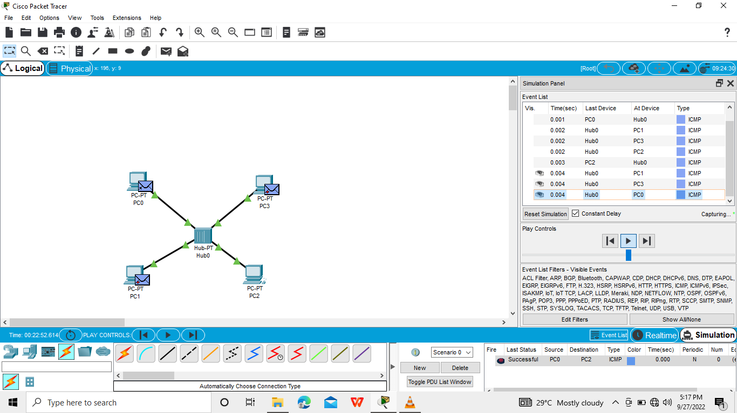
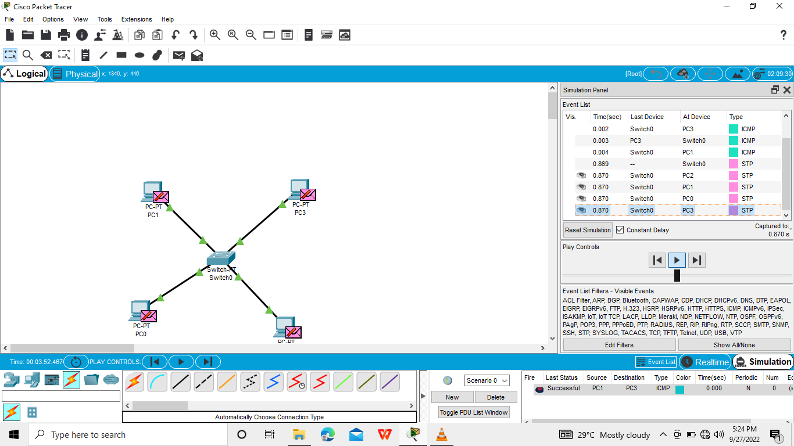
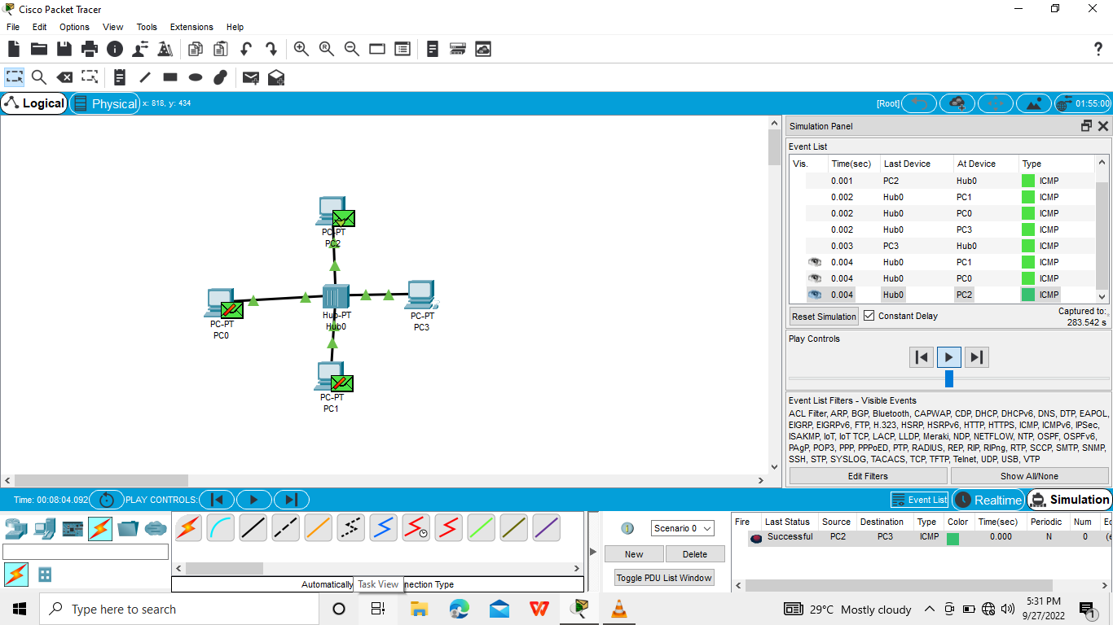

Slide 3
